Slide 1
ACCORDLY
getting you that sweet reward of a sweet new perfume
01
Notes:
HOOK (spoken only, before this slide appears, no visual, just talk to the room, then click through to reveal the title): "It's been 12 weeks. No day off. When I'm not here, I'm at the café, 20-plus hours a weekend, and I don't come out smelling like coffee and pastries, I come out smelling like milk and syrup, sticky, still. My only free time is a half-hour break, which I spend rabbit-holing on perfumes instead of actually buying one." Then click to reveal this title slide: "Accordly." (The Paper− story now opens the "why" section on the next slide, rather than living here.)

Slide 2
WHY
The Culprit: Commodity Paper-
Sold as a “personal” and “skin-close” scent just for me
Instead, it was so strong I was trying to run away from myself and ended up with a migraine I couldn't scrub off :(
on paper, it looked right
this isn’t just a one-off
sandalwood, amber, cedarwood
notes I already know I like
rating-based tools prioritise popularity
not composition
Iso E Super
wrongly compared to Ambroxan
composition tools (Scent IQ, PERFUMIST) do exist
but they’re still “black boxes”
the logic was there
but it still failed!
nothing is transparent
LET ME SEE >:(
02
Notes:
"The last time I bought a fragrance off the back of notes and reviews alone, it was Commodity's Paper−. Marketed as a quiet, personal space scent. Instead it was so strong I felt like I was trying to physically outrun my own scent trail. I ended the night with a migraine I could not scrub off. Keep Paper− in mind, it comes back later. On paper, Paper− had everything right. Sandalwood, amber, cedarwood, notes I already knew I liked. It also used Iso E Super, which I hadn't tried, but the recommendation compared it to Ambroxan, which I do like, from Glossier's You. (cue: just say 'similar', don't name the molecule mismatch). Reasonable logic. Still failed badly. And because the tool was a black box, I couldn't see why. That's the actual embarrassment, not the migraine, the fact that I have enough knowledge to have caught this myself, if I'd been shown the reasoning instead of just the result. This isn't just bad luck. Rating-based recommenders optimise for what's popular, not what's actually similar in composition. And the tools that do compare composition, like Scent IQ or PERFUMIST, are still black boxes. Nothing lets someone with real domain knowledge check the machine's thinking against their own." (Deliberate foreshadowing, Paper− returns as the negative control in the evaluation beat during "how.")

Slide 3
WHAT I BUILT
A fragrance recommender
made for those (me) who want (need) to know
MOST TOOLS
MINE
my input
→ black box calculation
→ mystery result
my input
→ transparent breakdown
→ now I know :D
03
Notes:
"So what did we actually build? At its core, this is a fragrance recommender that finds genuinely similar fragrances by composition, not by popularity."

Slide 4
WHAT I BUILT
Transparent by design
every recommendation comes with a breakdown, not just a score to blindly trust
Allegra Magnifying Musk Essence
Combined score
(Bvlgari, 2021)
0.498
notes similarity
perfumes similarity
0.707
0.288
Notes: ambrette (musk mallow), musk · Accords: musky, powdery, floral, animalic, aromatic, sweet
example output from the app (not to scale)
05
Notes:
"It's transparent by design, every recommendation comes back with a breakdown of why it was suggested."

Slide 5
WHAT I BUILT
A combined query
two independent inputs → scored separately → blended into one result
FRAGRANCES
YOU LIKE
NOTES
YOU LIKE
e.g. Libre
e.g. ambrette
BLENDED RESULT
scored separately
→ combined per recommendation
06
Notes:
"And the query itself is combined, search from a fragrance already loved, from notes picked by hand, or both at once."

Slide 6
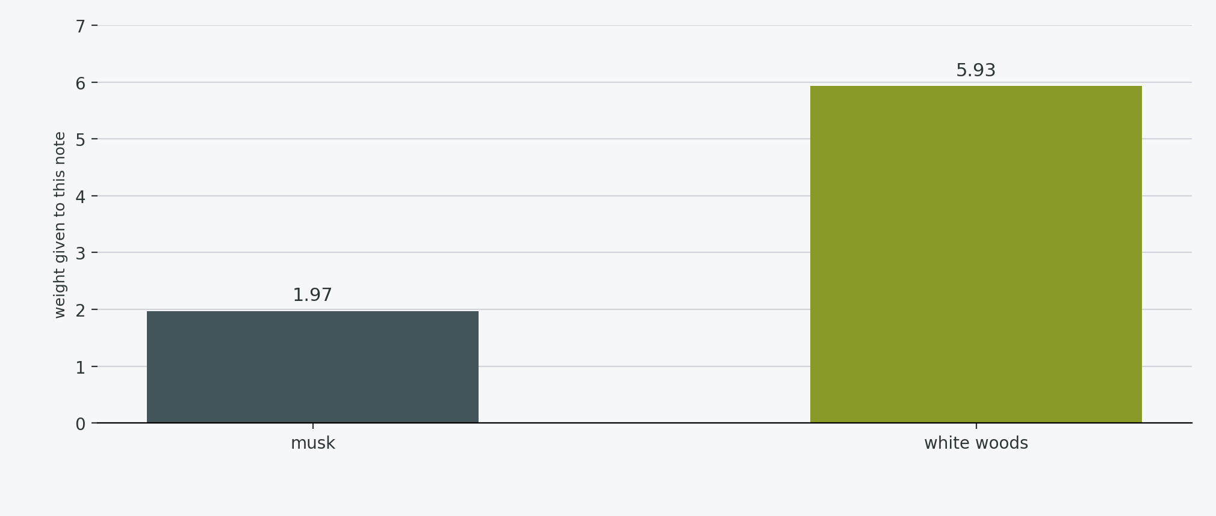
WHAT I BUILT
Rare notes carry more weight
these do the heavy-lifting when it comes to identifying a distinct personal fragrance, so why not prioritise them?
IDF WEIGHT (per note)
idf = log(N / (df + 1)) + 1
04
Notes:
"It's rarity-weighted, so a rare or distinctive note pulls more weight than a common note like musk, because a shared rare note is a stronger signal of true similarity."

Slide 7
HOW
Quantifying each perfume
NOTES
ACCORDS
BLEND
rare notes
weighted higher
→
scent families
weighted by strength
→
combined
into one score
COMBINED PERFUME VECTOR
perfume_score = blend_ratio × note_vector + (1 − blend_ratio) × accord_vector
07
Notes:
"Every fragrance becomes two fingerprints to the model: one from its notes, weighted so rare, distinctive notes count for more than common ones, and one from its accords, its broader scent families, weighted by strength. Those two fingerprints get blended evenly into a single similarity score. You can search from a fragrance you already like, from notes you pick yourself, or both at once, each one scored separately then combined."

Slide 8
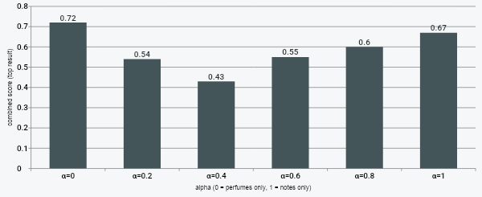
HOW
Blended by α
I chose α = 0.5, this chart shows how the combined score changes as α changes from 0 → 1
THE BLEND
combined_score = α x notes_score + (1 - α) x perfumes_score
08
Notes:
Same Libre → Idôle pairing shown in the app's explainer page. This chart sets up the circularity argument in "limits": why alpha=0.5 was chosen deliberately, not tuned.

Slide 9
HOW
Evaluate as “proof”
except, there's no absolute answer for what smells similar - good thing I know myself and my palate >:)
negative control: Paper−
a fragrance I know I don’t like must never appear in a top recommendations list
a pass/fail sanity check, not a strength measure
note-similarity vs. accord-overlap correlation (Pearson r)
positive correlation with an independently-labelled accord overlap
from Fragrantica's own tags, not my own similarity logic
09
Notes:
"Now, there's no answer key for what smells similar. So we had to prove this actually works, ourselves." (PAUSE) "Remember Paper−?" "We fed it into the model as a negative control, a fragrance we knew shared nothing with what I actually like. And it never showed up in the recommendations. That's the model doing its job. And we didn't tune the blend against our own data to get that result, that would've been rigging the test. We chose it deliberately, and documented why, so this is a real check, not a designed-to-pass one."

Slide 10
LIVE DEMO
Accordly app demo
switcheroo
1
Libre alone
top result = just a dupe :/ booooring
2
+ ambrette
diverging individual scores + combined score = completely different results :o
3
+ white woods
1 = notes dominance, 2 = the discovery I crave, 3 = that flipping dupe again D: go awayyyyyy
4
explained page
we pray this works to show my hard work
10
Notes:
DEMO. This entire section happens live in the app, this slide is just a placeholder / cue card, switch away from the deck now. ROUND 1, Libre alone: top result Léonie (Maison Alhambra, 0.788). Validate via domain knowledge (lavender/musk/vanilla overlap), then pivot: Maison Alhambra is a known clone house, most of the list is dupes, a high threshold alone just finds clones. ROUND 2, + ambrette (musk mallow): notes-similarity and perfumes-similarity visibly diverge on screen (0.707 vs 0.288, don't read these aloud), top result changes completely to Allegra Magnifying Musk Essence (Bvlgari). ROUND 3, + white woods: three results, deliberately nuanced, notes doing most of the work, a genuine discovery, and Léonie reappearing as fragrance-similarity reasserts itself. Land on: it's a balance, not a solved problem. EXPLAINER PAGE: brief walkthrough, shared notes, rarity weighting (musk 1.97 vs white woods 5.93), and the alpha-blend chart (0.72 → 0.43 → 0.67), which sets up the circularity argument in "limits" next.

Slide 11
LIMITS
Ground truths
the circular argument
the dupes & the dupes of dupes & the dupes of dupes of dupes D:
tuning alpha against what we already think is similar
the test would just confirm what we already believe then
querying a single (well-known) perfume
the clone(-house) war… they win…
same reason precision at top-k was rejected
it would just prove that my top 10 is… my top 10
(I do deserve a pat on the back tbf)
but the clones are dyslexic :o
impossible to merge every spelling quirk or variation
11
Notes:
This section follows directly from the explainer page's alpha chart, so reference it first. "You just saw that chart, the combined score swinging from 0.43 to 0.72 depending on where the alpha slider sits. Which raises an obvious question: why 0.5? Why not tune it? Because if we picked alpha by testing which value best matched what we already think is similar, we'd just be using our own taste to prove the model agrees with our own taste. That's circular. The test would only ever confirm what we already believed going in. Same reason we didn't score this with something like precision at top-k. There's no independent right answer for what smells similar, without one, any metric like that just quietly re-encodes personal opinion as ground truth and calls it evaluation. And time itself was a limit. My original proposal wasn't this at all, it was a flavour trend predictor for café drinks. That got scrapped, and so did the time spent on it. Then finding the right dataset for this project also took longer than planned. Which is exactly what's next."

Slide 12
NEXT
The dataset ratings, vote counts, & have/want data
1
collaborative filtering
right now everything is composition-based, what a fragrance is made of. collaborative filtering would recommend based on behaviour instead, what people with similar taste also liked. a different paradigm, not attempted this capstone.
2
another plausibility check
instead of generating recommendations, that rating and vote data could check them,” do top results also share similar ratings or have/want patterns?” another form of supporting evidence, alongside the checks already built.
12
Notes:
"So what's next. The bigger direction is collaborative filtering. The dataset this is built on actually has a lot we haven't touched yet, ratings, vote counts, have/want data. Right now, everything is based on composition, what a fragrance is made of. Collaborative filtering would recommend based on behaviour instead, what people with similar taste to you also liked. That's a genuinely different paradigm to everything we've built so far, and it's a natural next step. One more thought before I finish, that same rating data could also work the other way, not to generate recommendations, but to check them. If my top results for a fragrance also tend to share similar ratings or similar have/want patterns, that's another form of evidence the model's on the right track, alongside the checks we already built."

Slide 13
thank you
<3
13
Notes:
Buffer slide. If asked "what didn't work / what did you learn", return to the Limits slide verbally: the alpha circularity decision and the rejected precision@k metric are the strongest material for that question.

